Slide 1

Car Price Prediction
Chethan B. K.

Slide 2
Table of Contents
Introduction
Analytical Problem Framing
Data Analysis
Assumptions
Machine Learning Models
Results and Conclusion
Limitations and Scope for Future Work

Slide 3
Introduction
With the covid 19 impact in the market, we have seen lot of changes in the car market. Now some cars are in demand hence making them costly and some are not in demand hence cheaper
The market value is based on a number of factors, including demand, supply, options, and incentives. The market value of a vehicle usually falls somewhere between the sticker price and the invoice price. Because the market value is an average, some people will pay more than that amount, while others will pay less
A car's value is determined by many factors: the popularity of the make and model of your car, vehicle specifications, trim levels, physical appearance, mileage, consistent maintenance and working condition

Slide 4
Analytical Problem Framing
In this analysis, we will be predicting the sale price of a used car in Indian market
Using this as a base, I have collected the data from few websites. The data was collected for the car body types like sedan, SUV/MUV, hatchback, minivan, coupe/convertibles
Once the data is collected, the data will be cleaned and pre-processed with all the necessary tools and the same will be used to build machine learning models in order to predict the price of the same

Slide 5
Data Analysis
The dataset has 6590 rows and 13 columns. Using this dataset we will be training the Machine Learning models on 70% of the data and the models will be tested on 30% data.
Since we have removed the null values from the dataset during the data collection stage, we can expect outliers and un-realistic values for certain variables
I can see that there are few repeated categories in some variables, which needs to be handled before we can proceed with further steps.

Slide 6
There are no null values in the dataset and all the columns contains numerical data. Below are the features we gathered from used car websites.
Price | Listed Price of the car
year | Year of manufacturing of the car
fuel | Type of fuel used in the car
trans | Type of transmission in a car (Automatic/Manual)
mile | Number of Kilometres driven
color | Color of the car
owner | Number of previous owner for the car
engine | Engine size of the car in CC (Cubic Centimetre)
seating | Seating capacity of the car
location | Car’s location
Body | Type of car (ex. SUV, sedane, hatchback)
make | Brand name of the car
model | Car’s model/variant

Slide 7
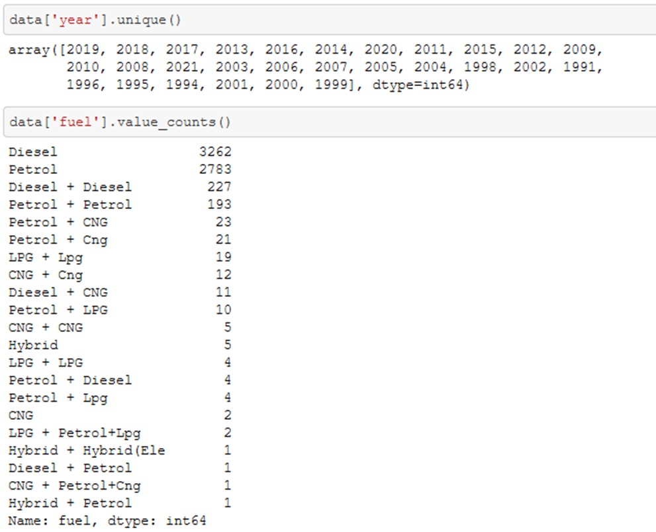
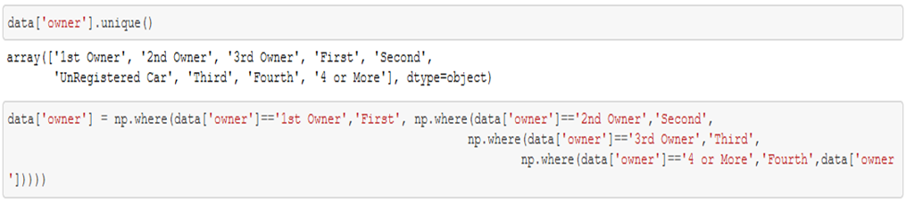
I can see that there are few repeated categories in the ‘fuel’ and ‘owner’ columns, which needs to be handled before we can proceed with further steps.
I’m using numpy to handle the repeated categories in the ‘fuel’ column.

Slide 8
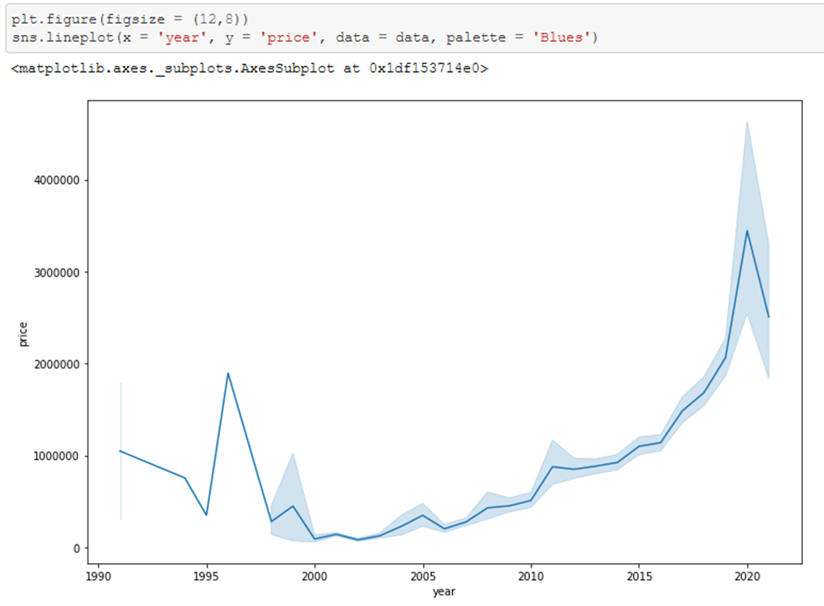
We can proceed with finding the correlation of the dependent variable with the independent variables. Let’s look at some of the highly correlated variables
I can say that there is a positive relationship between manufacturing year and the list price. Newer cars were sold at higher prices

Slide 9
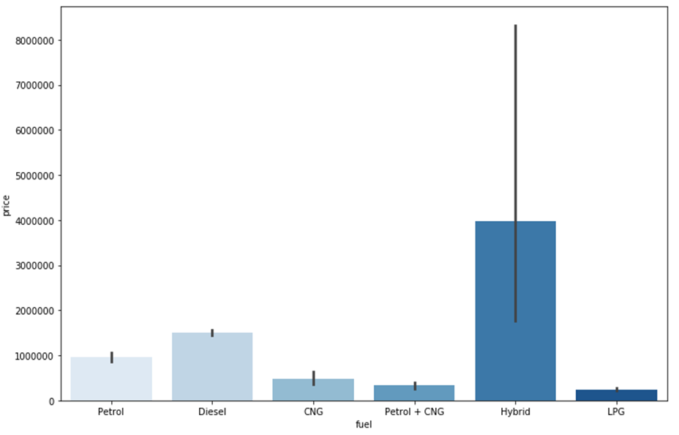
fuel v/s price
Hybrid cars were sold at higher prices followed by cars that used diesel as fuel when compared to others.

Slide 10
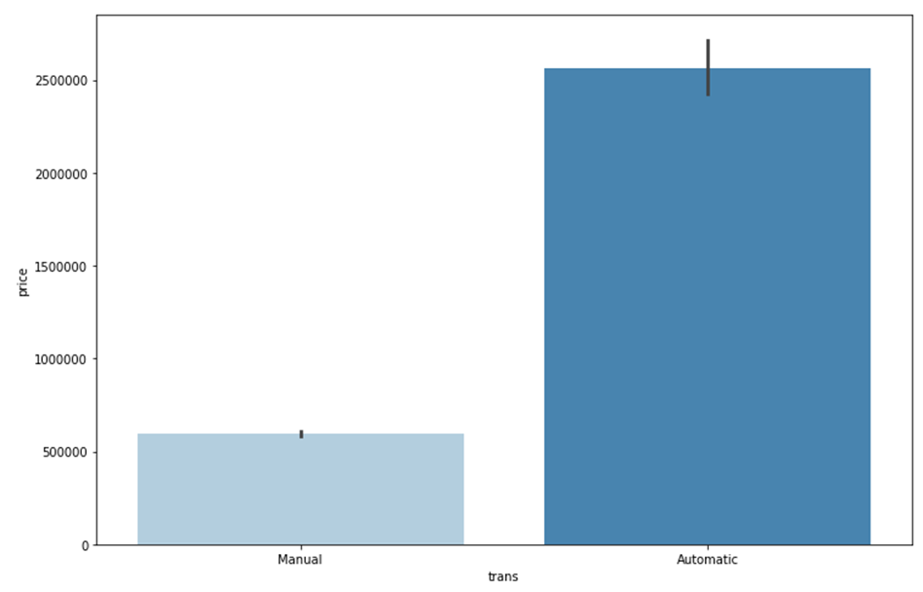
trans v/s price
The price of cars having automatic transmission was sold at much higher price when compared to manual transmission cars

Slide 11
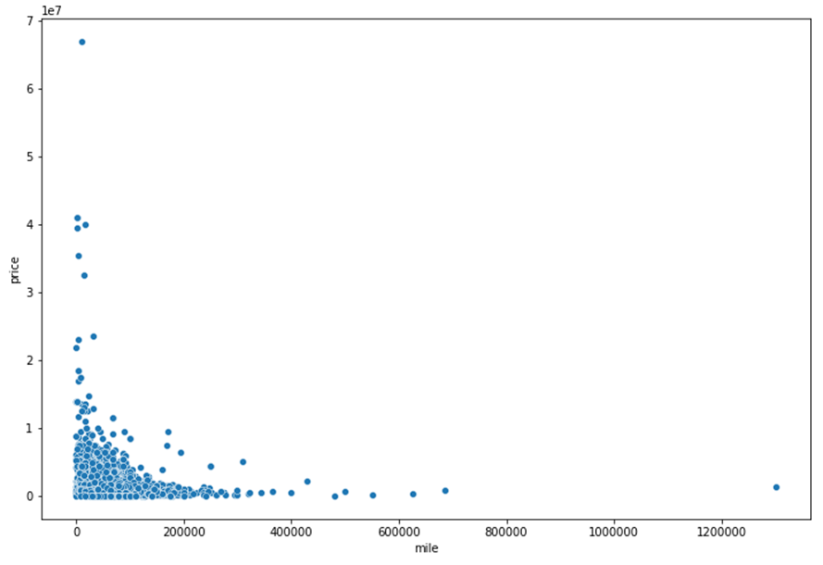
mile v/s price
The price of the car decreases with the increased ‘Kilometres driven’ for a used car

Slide 12
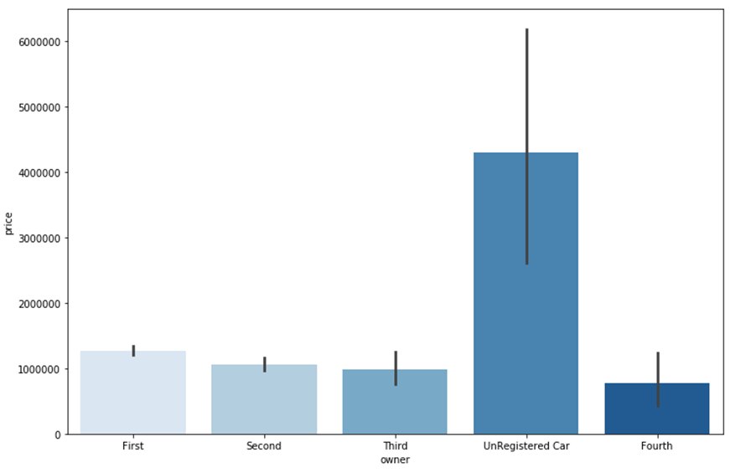
owner v/s price
I can say that the unregistered cars were sold at higher prices followed by the cars with single owners.

Slide 13
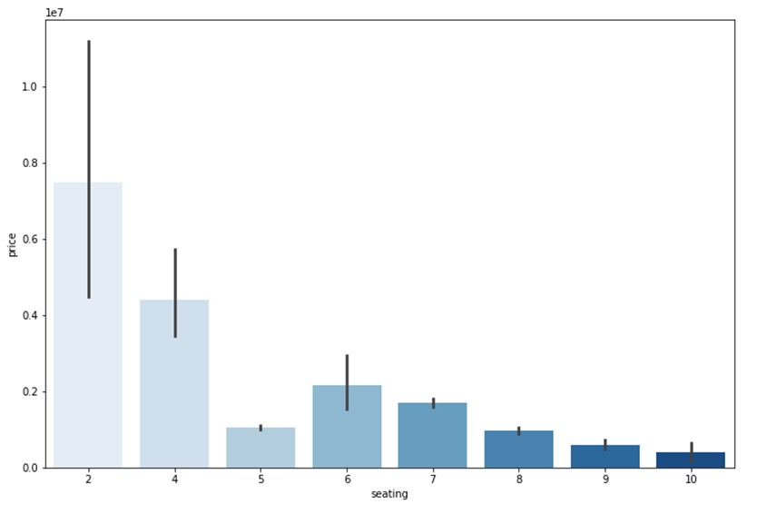
seating v/s price
From the above analysis, I can say that the cars with less number of seats are sold at higher prices because most of the 2 seater cars are coupe/convertible or sports car.

Slide 14
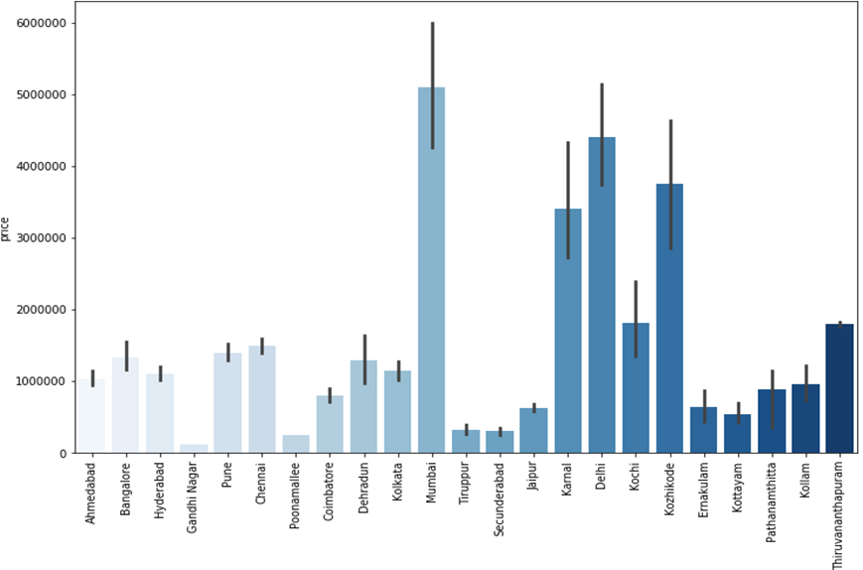
location v/s price
Cars at Mumbai, Delhi and kozhikode were sold at higher prices when compared to other cities

Slide 15
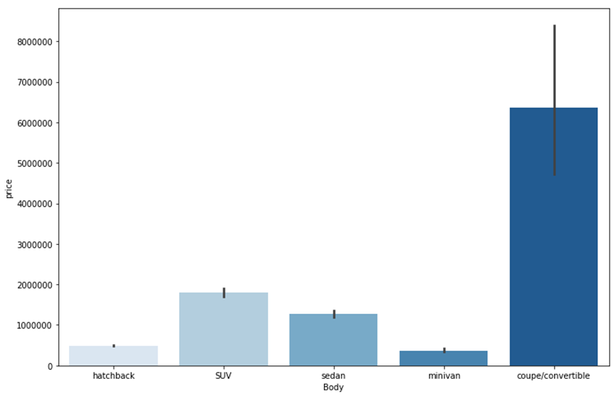
body v/s price
From the above visual, I can see that coupe/convertible cars were sold at higher prices, followed by SUV, sedan and hatchback

Slide 16
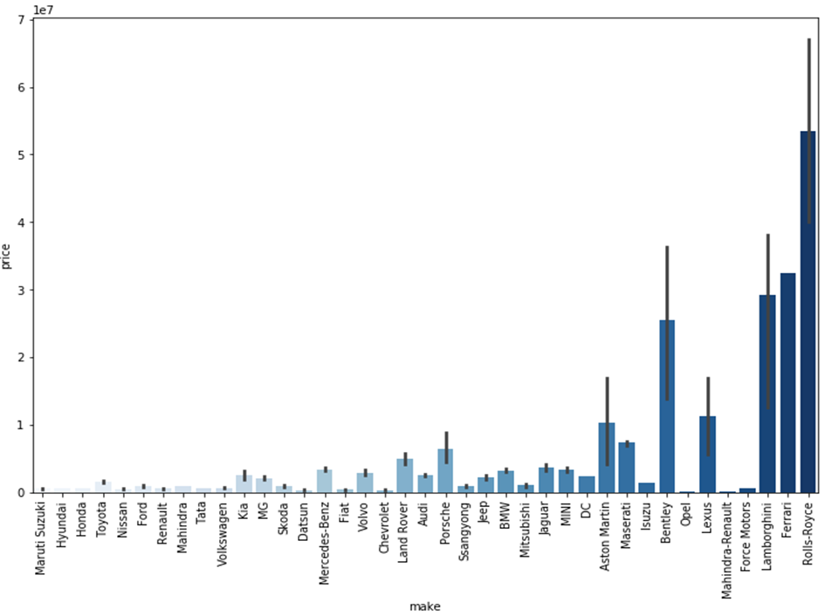
make v/s price

Slide 17
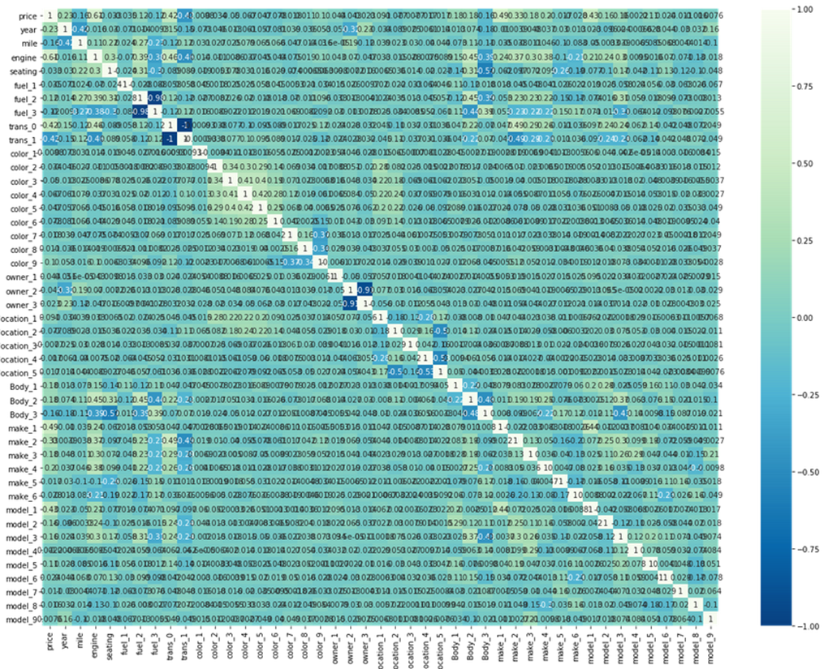
Now that we have analyzed the correlation between the dependent and independent variables, we can move forward in analyzing the multi-collinearity. From the heat-map I can see some of the independent variables are correlated and I can see multi-collinearity in the dataset.

Slide 18
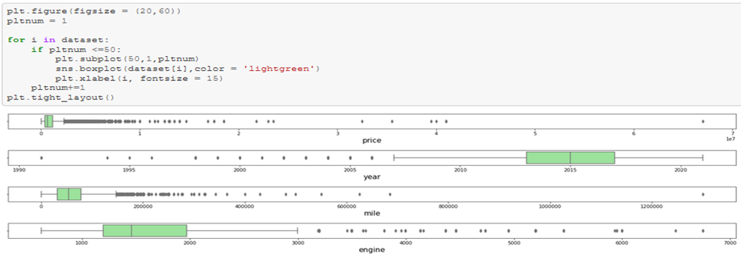
Although, there are few independent variables which are highly correlated with each other. However, I’m not removing them at this stage because multi-collinearity in a dataset will not affect the prediction in any manner.
Now I’m proceeding with further analysis and checking for outliers in the continuous data variables within the dataset using boxplot
I can see that there are lot of outliers in the dataset. Hence I’m proceeding with handling the outliers with the z-score method.

Slide 19
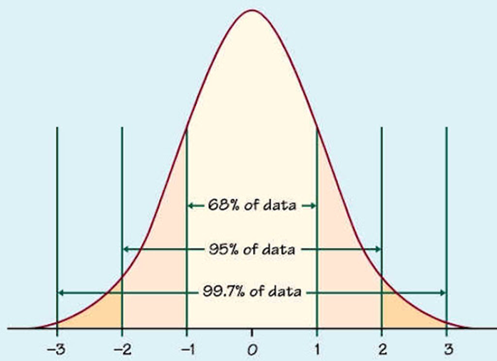
It is assumed that close to 99.7% data lies between -3 to +3 standard deviation. We can consider the remaining data (0.03) to be outlier.
Therefore using the z-score method, I’m taking the data within the range of -2.1 to +2.1 standard deviation to control the outlier.

Slide 20
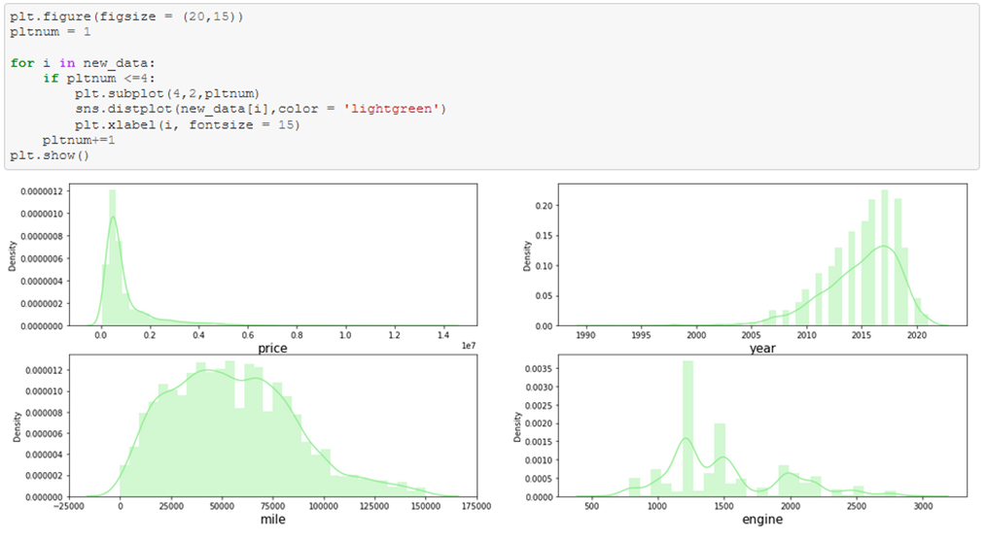
Checking for skewness for continuous variables in the dataset using the distribution plot from a seaborn library
From the above distribution, we can clearly see that continuous data variables does contain outliers.
In order to be a good dataset, we assume that all the continuous variables follow normal distribution. However I can see that the continuous columns are skewed and we will have to control skewness to make data follow normal distribution.

Slide 21
It is considered that the skewness co-efficient within the range of -0.5 to +0.5 is acceptable. Proceeding with the same assumption to get the skewness under control.
In order to perform the same we are using power transformation using cube-root transformation on the entire dataset excluding the target variable.

Slide 22
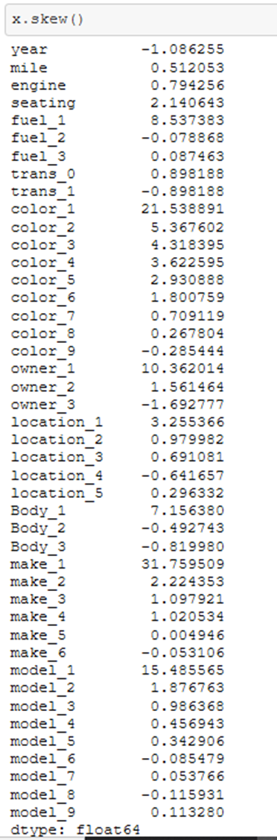
Most of the skewness are under control except few and we are proceeding with the model building assuming that outliers is not the cause of the skewness in the dataset

Slide 23
Assumptions
Although there is skewness present in some of the variables post transformation, we assume that this is not because of the presence of outliers, however it is the shape of the data itself
We assume that all the variables follow normal distribution
The multi-collinearity in the dataset will not affect the prediction.

Slide 24
Machine Learning Models
Below are the details of the machine learning model used
Machine Learning Models | Model's R2 score | Cross validation score | Root Mean Squared Error (RMSE | Difference of R2 and CV
Linear Regression | 0.649705 | 0.598677 | 692726.9643 | 0.051029
Random Forest Regressor | 0.926831 | 0.825579 | 316599.595 | 0.101251
Extra Trees Regressor | 0.941396 | 0.87313 | 283341.9102 | 0.068266
XG Boost Regressor | 0.947447 | 0.846206 | 268314.4239 | 0.101241

Slide 25
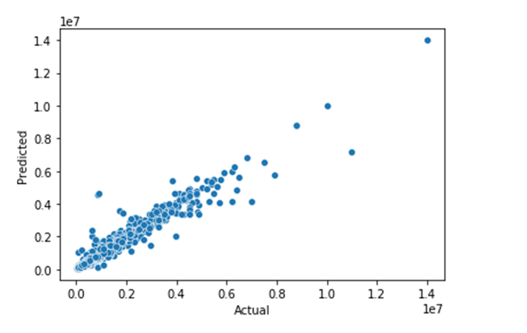
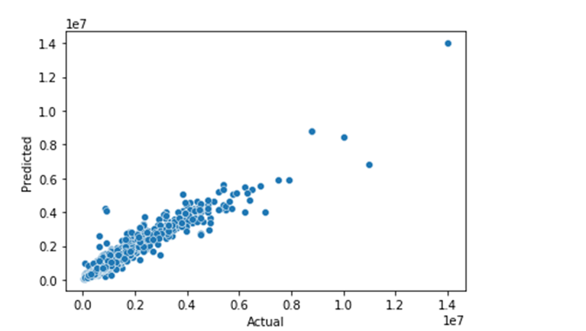
As per the previous slide the chosen best model for the dataset is Extra Trees Regressor therefore performing Hyper Parameter Tuning on the same.
Below is the plot for Actual and Predicted sale price for base and Hyper Tuned Extra trees Regressor
Base Extra Trees model Hyper-Tuned Extra Trees Model

Slide 26
Results and Conclusion
We have successfully built a model using multiple models and found that the Extra Trees Regressor model.
Below are the details of the model’s metrics predicting the dataset
• R2- score of 0.92
• RMSE of 320828

Slide 27
Limitations of this work and Scope for Future Work.
1. Due to the presence of lot of outlier, we are unsure whether the model is going to perform well to a completely new dataset.
2. During data-collection, there are certain websites that do not provide the necessary information on the used car due to which the data collected was limited to ~6000 data points.
Other than these above limitations, I couldn’t find more scope for improvement.

Slide 28


